Slide 1



Simplified Self-Service BI

Slide 2
Teaches you how to connect, analyze & visualize massive amounts of data from familiar interface of Excel
Power Pivot is an Excel add-in you can use to perform powerful data analysis and create sophisticated data models. With Power Pivot, you can mash up large volumes of data from various sources, perform information analysis rapidly
Large Data -> Apply Formulas(Lookup) ->Joins->Relationships ->Analysis ->Reports
File Size Compressor –Drastically decrease in Power Pivot in comparison to excel
Data Model is used for building a model where data from various sources can be combined by creating relationships among the data sources. A Data Model integrates the tables and enabling extensive analysis using PivotTables, Power Pivot, and Power View.
A Data Model is created automatically when you import two or more tables simultaneously from a database.

Slide 3
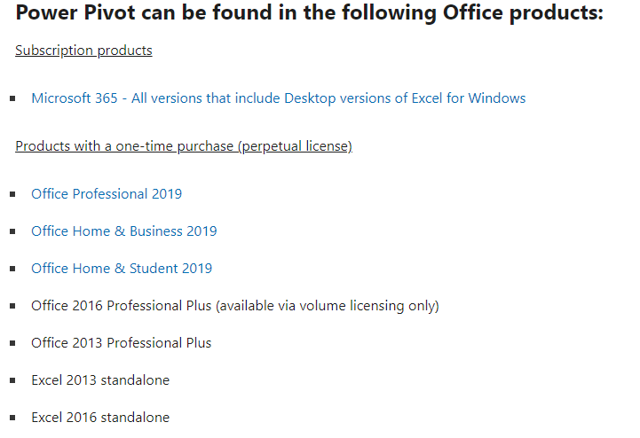

Slide 4
